Slide 1
Enhancing ESL Instruction while Building Digital Literacy
Rebecca Eller-Molitas
New Readers Press
This Photo by Unknown Author is licensed under CC BY-SA

Slide 2
Agenda:
Welcome!
Digital literacy
Key components of ESL
Standards based planning
Blended learning
Lesson idea – manufacturing
Voxy EnGen
Q & A + Goodies

Slide 3
How have you used technology today?
This Photo by Unknown Author is licensed under CC BY-SA-NC
Notes:
Take 3 minutes. Talk with the person next to you. How have you used technology so far today? Ask for volunteers to share out.

Slide 4
Tech
Email
Headphones
Texts
Maps
Uber Lyft
Apps
Web search
Ticket machine
Podcasts
E-reader
Phone calls
TV

Slide 5
Challenges?
This Photo by Unknown Author is licensed under CC BY
Notes:
Now talk together with your partner or small group. What challenges might you have faced in completing these digital reliant tasks if you were an English language learner? Volunteers share out challenges.

Slide 6
Reading
text
Writing
email
Speaking
speech to text
maps
email
maps
apps
texting
voicemail
Listening
phone calls
Digital Literacy
Notes:
In English language courses, we teach 4 main skills. Reading, Writing, Speaking, & Listening. We need these 4 skills to complete many of our daily tasks. REVIEW EACH SECTION of chart. But as we’ve just demonstrated that we also need CLICK something else to accomplish all of these daily tasks. CLICK. Digital literacy.

Slide 7
Notes:
No only are digital skills relevant to our students every day lives, but they’re also a part of the CCR and ELP standards. This is a word cloud made of 75 key words from the CCR and ELP standards. What do you notice? (Rebecca - Focus on the words in purple and blue).

Slide 8
Now what?
This Photo by Unknown Author is licensed under CC BY
Notes:
We know that technology is an important part of everyday life. But we also have other responsibilities as language teachers. How do we meet students language needs while also building digital skills? We don’t have enough time in this session to look at every instructional model and delivery scenario, so we’ll focus on one that has broad appeal – blended learning.

Slide 9
Blended Learning
Blended learning is an instructional approach that has face-to-face class or tutoring integrated with online learning in which students have some “control over time, place, path, and/or pace.”
Blended learning definitions. (2019). Clayton Christensen Institute
Notes:
So what is blended learning? According to the Clayton Christensen Institute….READ definition above. WHY would a program choose blended learning? Lots of reasons! Blended learning helps us become more accessible to learners not previously reached
• has been shown to be more effective for adult basic skills learners than only face-to-face or only online learning
• extends learning outside of classes or tutorials so students can make progress more quickly
• provides a way for learners to review what was covered if they need reinforcement, or to “make up” missed classes
• supports flexible programming that helps learners persist
• makes homework more convenient and appealing
• creates opportunities for learners to build digital literacy and online learning skills
• makes systematic monitoring of progress easier to track and document
Blended learning is a great mix of the art and the science of teaching because it allows teachers to do what we do best and technology to do what it does best.

Slide 10
How does it work?
Notes:
There are many ways to use blended learning effectively. Today we’ll focus on these two popular methods. REVIEW method 1. REVIEW method 2. In a few minutes, we’re going to look at an example of a lesson I’ve used with my own ESL class. Both of these structures would work great.

Slide 11
ESL Using the News
Warm up
Listening
Reading
Speaking
Writing
Workplace vocabulary
Notes:
In this mini lesson plan, I’ll include activities you can use in-person or during a Zoom class. GO OVER parts of the lesson.

Slide 12
Speaking & Listening
Notes:
This article is taken from News for You. News for You is a weekly newspaper for adult learners offered in print and digital format. 7 articles from the Washington Post and Associated Press are carefully rewritten with permission 48 weeks out of the year; 4 of the stories at reading levels 4-6 (low intermediate) and 3 at levels 3-4 (high beginning). For higher level readers, you can apply these same principles to other resources, such as Newsela or Common Lit.
In this lesson, I’d begin to warm up the class by asking the students what they see in the photo. What is the man doing? Where is he? Does he like his job? How do you know? Do you know anyone who works in a factory? What kinds of jobs can you do in a factory? Next, ask students to look at the title and the caption below the photo. What do you think this story will be about? CLICK. After students get a general idea of what the story will be about, you can use the built-in audio feature to have students listen to the article. Follow-up with some simpler comprehension questions such as What was manufacturing work like in the past? What is like today?

Slide 13
Reading & Vocabulary
Reading & Speaking
Notes:
Depending on the level of your students and the purpose of your lesson, you may want to teach key vocabulary before students begin reading the article themselves. Key terms are defined in both the print and digital forms of NFY. If you’re using the digital version, you’ll see all vocabulary for this edition listed at the side of the page. Not all vocabulary words will be included in this article, so you may want to note the relevant words for yourself before class. Hover you mouse over any word in the list to see a simple definition and the part of speech. Key terms are also highlighted in blue within each article. Hover over any term to see the meaning and POS. After reviewing the vocabulary you’re ready to have students read.

Slide 14
Writing
Writing or Speaking
According to the article, what are some thing that have replaced human workers?
Why are many high-tech jobs in the U.S. still open?
Do you use a computer at your job? Is your job high-tech or low-tech?
Would you like to get training for a high-tech manufacturing job? Why or why not?
What do you think would be some good things about having a high-tech manufacturing job? What would be some bad things?
Notes:
These questions are from the NFY teacher’s guide. If you want to help students recognize the language of academic questions or if they have trouble with question formation, you can ask them to copy these questions and even to answer in complete sentences, but there are lots of ways to do this. After completing these, you can use another activity from the teacher’s guide and have students what they’ve learned by moving into a visual literacy activity creating Venn Diagrams.

Slide 15
Visual Literacy
Writing
.
High-tech job
Low-tech job
Both
Notes:
Let students know they’ll use information from the story and their own ideas to show how having a high-tech job and having a low-tech job are the same and different. Give students a handout with a Venn Diagram, ask them to draw one on a sheet or paper, or – if you’re teaching virtually – Google Jamboard is a great free tool of collaborating on something like this.

Slide 16
The VOXY EnGen® Solution Voxy’s solution is built to improve learner outcomes
Personalized Courses
100% Authentic Content
Live Instruction
Reporting & Tracking
Assessment
Notes:
To create a blended learning scenario and build the digital literacy of students, let’s look at what you can do with Voxy. This is a great option for both learning stations in the classroom and for asynchronous work outside of class. What is Voxy?
Voxy EnGen is an industry-leading Online English Learning program that delivers highly effective instruction through
Personalized courses – in general and career-aligned English
Authentic content using real media sources updated daily
As an option or in addition to live instruction provided by the program instructor/s in class, Voxy offers live virtual instruction from native English speaking, certified teachers all over the world
Ongoing and scheduled proficiency assessments
And detailed analytics for students and instructors
With around-the-clock, seamless mobile and web access!

Slide 17
VOXY EnGen® Uses Proven Research
Decades of research show that four key ingredients are needed for effective language learning to take place. These are called the principles of Second Language Acquisition (SLA)
Notes:
Decades of research show that 4 key ingredients are needed for effective language learning to happen. They’re called the principles of Second Language Acquisition:
(CLICK) INPUT as learners listen and read for information.
(CLICK) OUTPUT as they use what they’ve learned to communicate ideas with clarity and fluency through speech and writing.
(CLICK) INTERACTION as they converse and collaborate with other native and non-native speakers in English.
(CLICK) And FEEDBACK as they receive encouragement, correction, and additional instruction based on detailed performance data.

Slide 18
Key Features:
Specific Career Pathway exploration courses
Multi-media format in the lessons support learner engagement
Contextualized content promotes understanding and connection
Academic-skills focused
Promotes a basic understanding of individual careers/daily activities

Slide 19
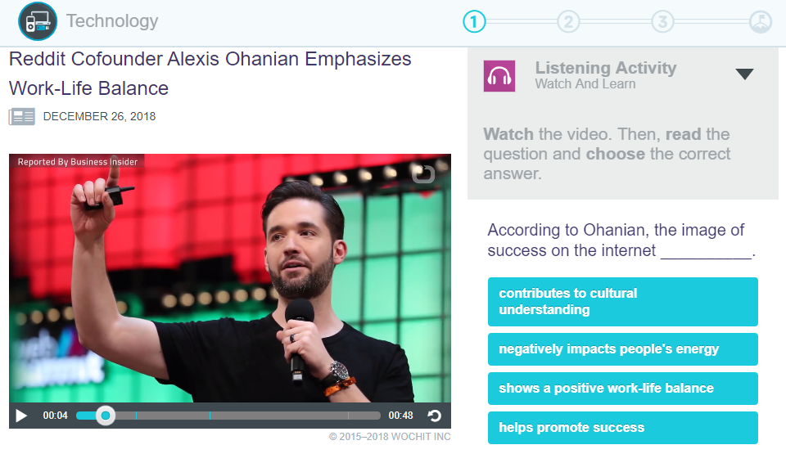
Task-Based Approach Voxy EnGen combines the science of language learning with a proven task-based teaching approach so your learners can complete real-world tasks that matter to them in English.
Notes:
VOXY EnGen combines the science of learning a language with task-based teaching (having students do meaningful tasks using authentic language)

Slide 20
Where does it all come from?
60,000+ HOURS
OF CONTENT
100% AUTHENTIC
CONTENT
UPDATED DAILY
Featuring content from sources such as:
Notes:
Instead of using scripted, possibly outdated learning materials, Voxy EnGen teaches English using a library of real media sources that is updated every day. These resources from licensed content providers (articles, videos, conversations, and photos) are turned into task-based lessons using Voxy’s patented technology.

Slide 21
Career Pathway Exploration:
Career Categories:
Career Category Sub-sets:
Healthcare
Food & Beverage
Tourism & Hospitality
Entrepreneurship
Construction
Manufacturing
General Business
Customer Service
Certified Nursing Assistant (CNA)
Patient Care and Support
Home Health Aides
Intro to Nursing
Pharmacy Technicians
Intro to Dentistry
Automotive Technician – coming soon
Aircraft Maintenance Technician
Maritime
Oil and Gas
Warehouse Machinery
General Office Workplace Skills
Notes:
In addition to an endless library of personalized units and lessons, Voxy offers general English proficiency courses (7 levels ranging from beginner-literacy to advanced) and career-aligned English courses such as the food & beverage industry, construction, healthcare, etc to keep learners engaged and help them achieve their life and learning goals. Today, we’re going to focus on Manufacturing.

Slide 22
Focused on Outcomes
More than 4 million learners have used Voxy
A market leader in private language schools worldwide
Featured in Forbes as an Edtech industry leader
Notes:
Focused on outcomes, over 4 million learners have used VOXY, 90% of them improving their English proficiency! Recognized as an industry leader by private schools worldwide and Forbes!
(CLICK) And now NRP offers this innovative solution to adult literacy programs and learners!

Slide 23
Getting Started
Support in 14 different languages
or
or
Student takes VPA
Takes about 30-45 minutes
Student chooses level
Teacher assigns level
Bypasses student testing/selection
from low beginning to advanced
level descriptions provide guidance
2 test options – beginner and intermediate
Based on pre-existing level assessment
Recommended
Notes:
So how does it work?
Well first, students can choose from 14 languages (CLICK) to set their profile in their native language. This will allow them to receive instructions, notifications, and other support in their own language. English, LATAM Spanish, Portuguese, Arabic, Chinese (Mandarin), Japanese, Malay, Russian, Turkish, Vietnamese, Korean, French, German, Thai to name a few.
This is particularly helpful for learners at lower reading levels who would otherwise struggle with site navigation and activity directions.
Then, starting level is determined in one of three ways. (READ SLIDE and CLICK through))

Slide 24
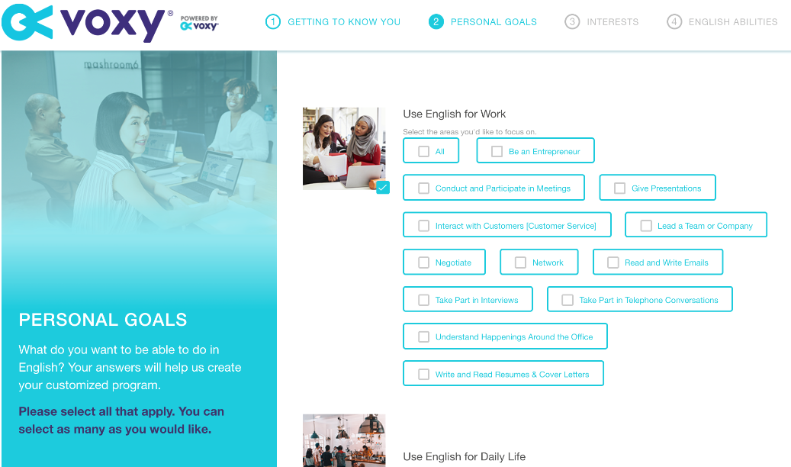
Needs Analysis
Support in 14 different languages
Notes:
Next, a comprehensive needs analysis gathers learner-specific data regarding learning goals
English for work, daily life, test prep, travel…

Slide 25
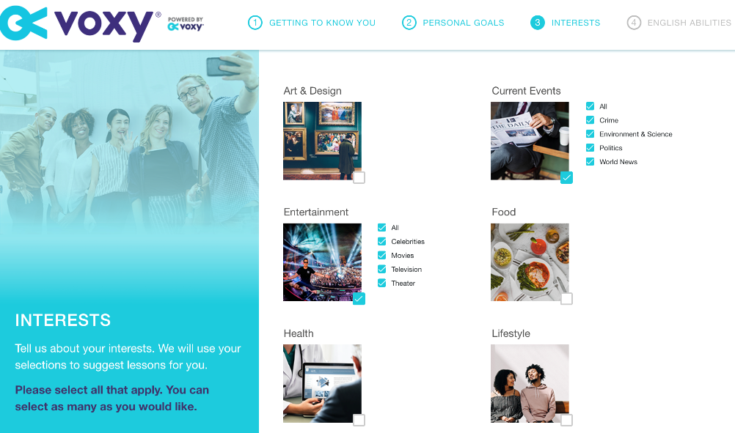
Needs Analysis
Notes:
And personal interests – food, health, dating & relationships, entertainment, technology…

Slide 26
Voxy EnGen’s Software
Student level
Student goals
Student interests
3 highly-personalized units are generated
Notes:
Voxy’s patented software then combines all this information - the student’s level, stated learning goals and personal interests to start her/him off with 3 highly-personalized units.

Slide 27
Discovering Career Pathways in Context Using Voxy
Warehouse Machinery
Manufacturing
Notes:
Let’s look at how we might support our learners as they continue learning about manufacturing.

Slide 28
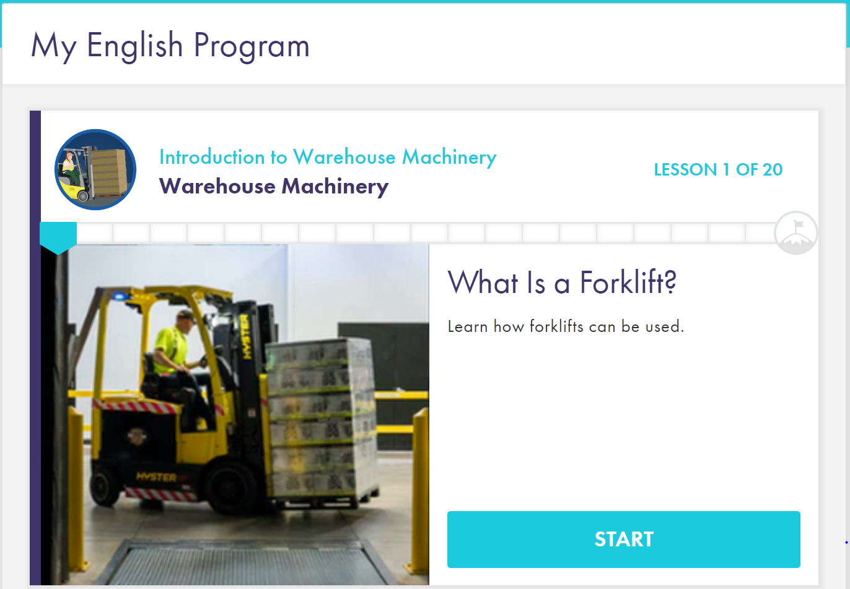
Contextualized Content:
Vocabulary terms and phrases
Descriptions of job-related tasks and tools used
Examples of frequent on-the-job skills performed

Slide 29
Focus on Academic Skills:
Vocabulary building
Reading & writing skills
Listening, speaking and pronunciation skills
Grammar exercises
Notes:
We’ll be able to maintain a focus on academic skills just as we did with the in-person (or synchronous) portion of our instruction. Voxy lessons contain instruction on READ slide.

Slide 30
Home Page:
Students launch the course from the Home Page
Topic and lesson number is listed in the progress bar

Slide 31
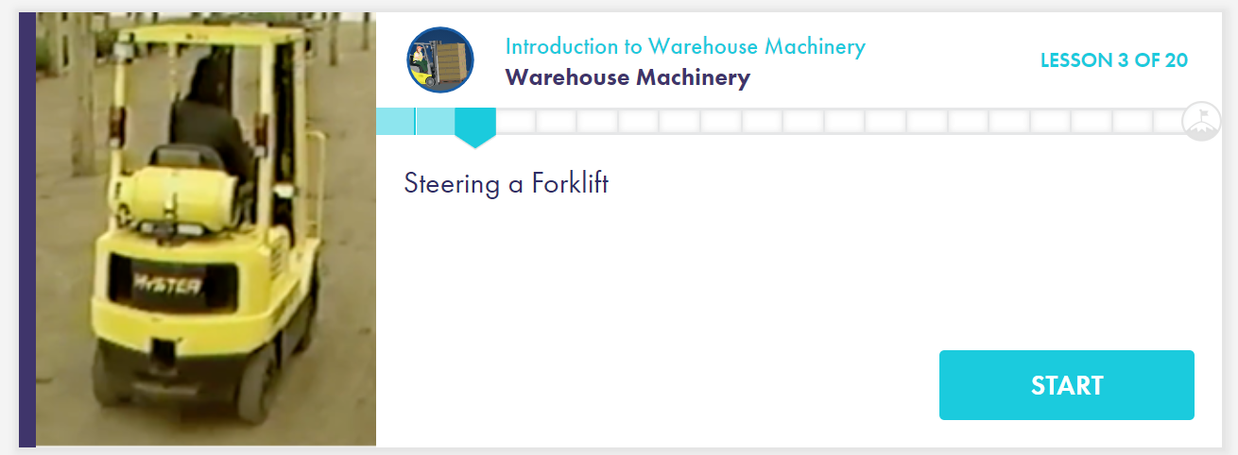
Bookmarking and Repeating:
Lessons are auto-bookmarked
Lessons chunked out/easy to repeat from the home page
Notes:
Built-in study tools empower students to take control of their progress by allowing them to mark areas where the need to review and repeat lessons where they struggled.

Slide 32
Vocabulary in Context:
Listen, interact and respond to vocabulary in context related to the subject
Notes:
Students are able to practice listening and interacting with vocabulary in context. The program uses the voices of native English speakers, so that learners can improve listening skill with authentic voices.

Slide 33
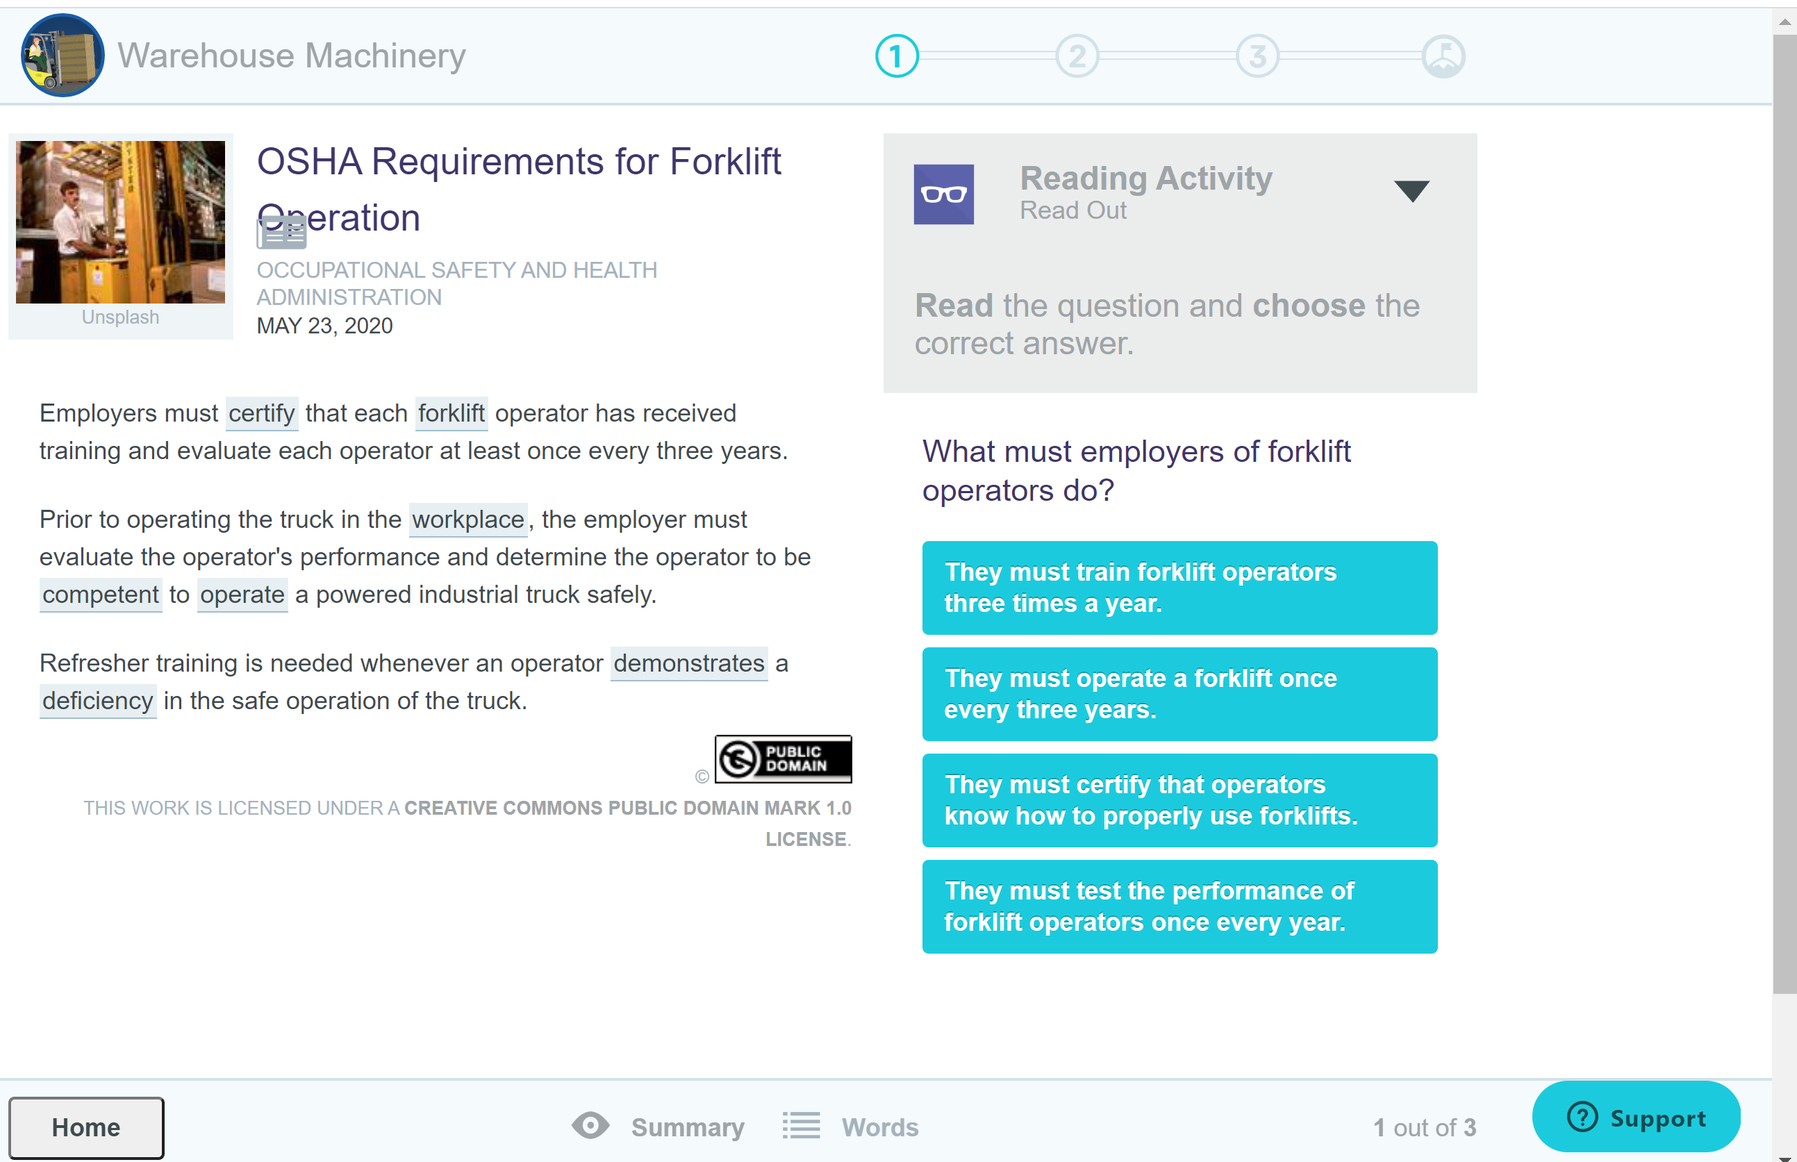
Reading Activity:
Students read for understanding
Interact with the vocabulary terms
Improve active reading skills
Increase reading comprehension

Slide 34
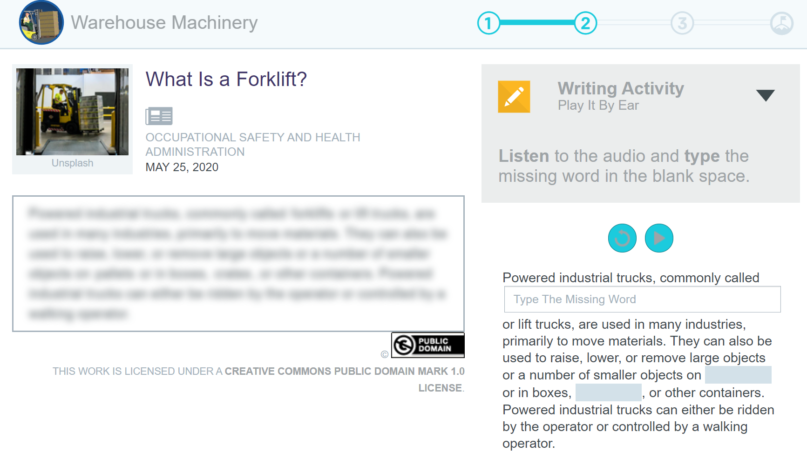
Writing/Digital Literacy Exercises:
Students listen to a paragraph being read to them and respond by typing in their answers
Spelling skills

Slide 35
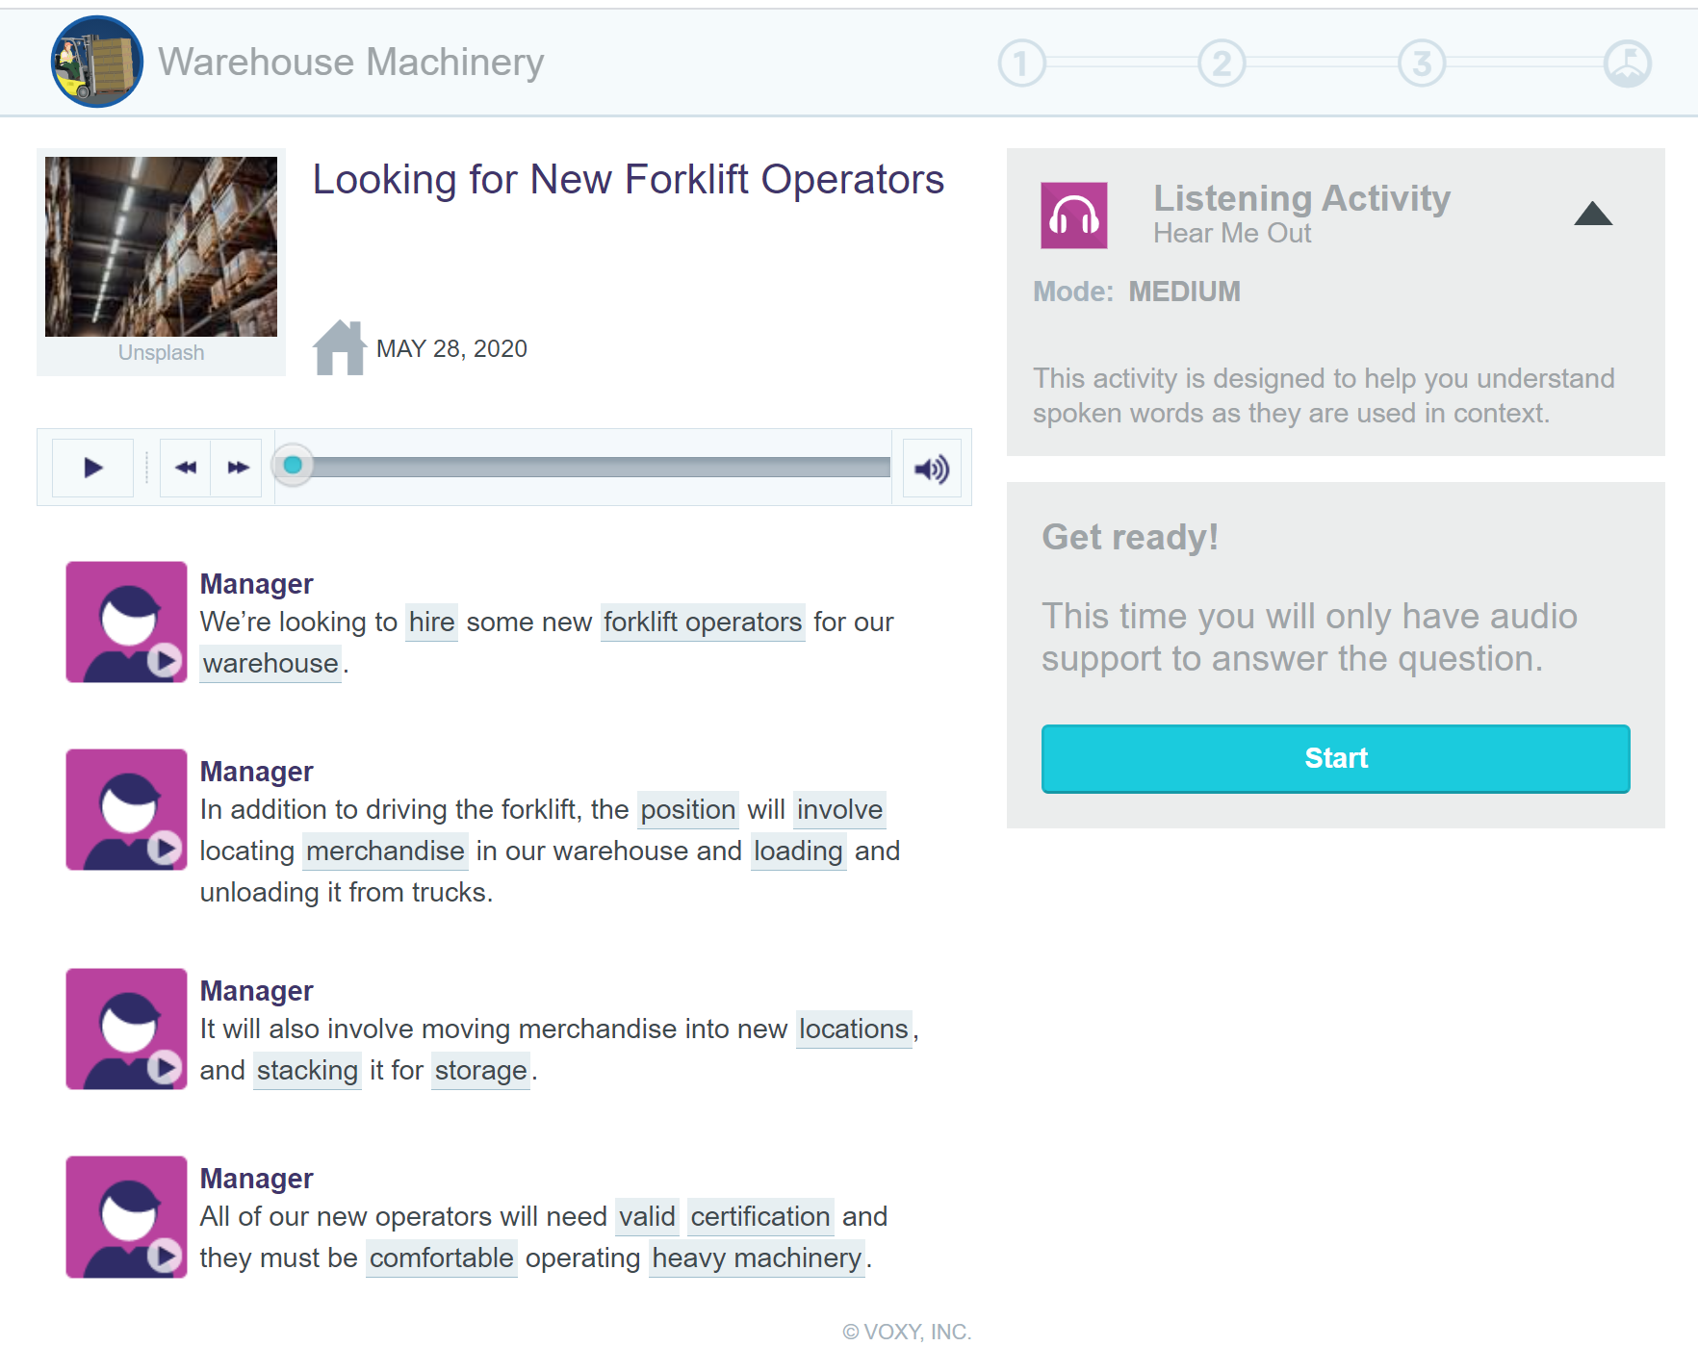
Listening Activity:
Listen to audio
Review and complete sentences
Interact with vocabulary terms

Slide 36
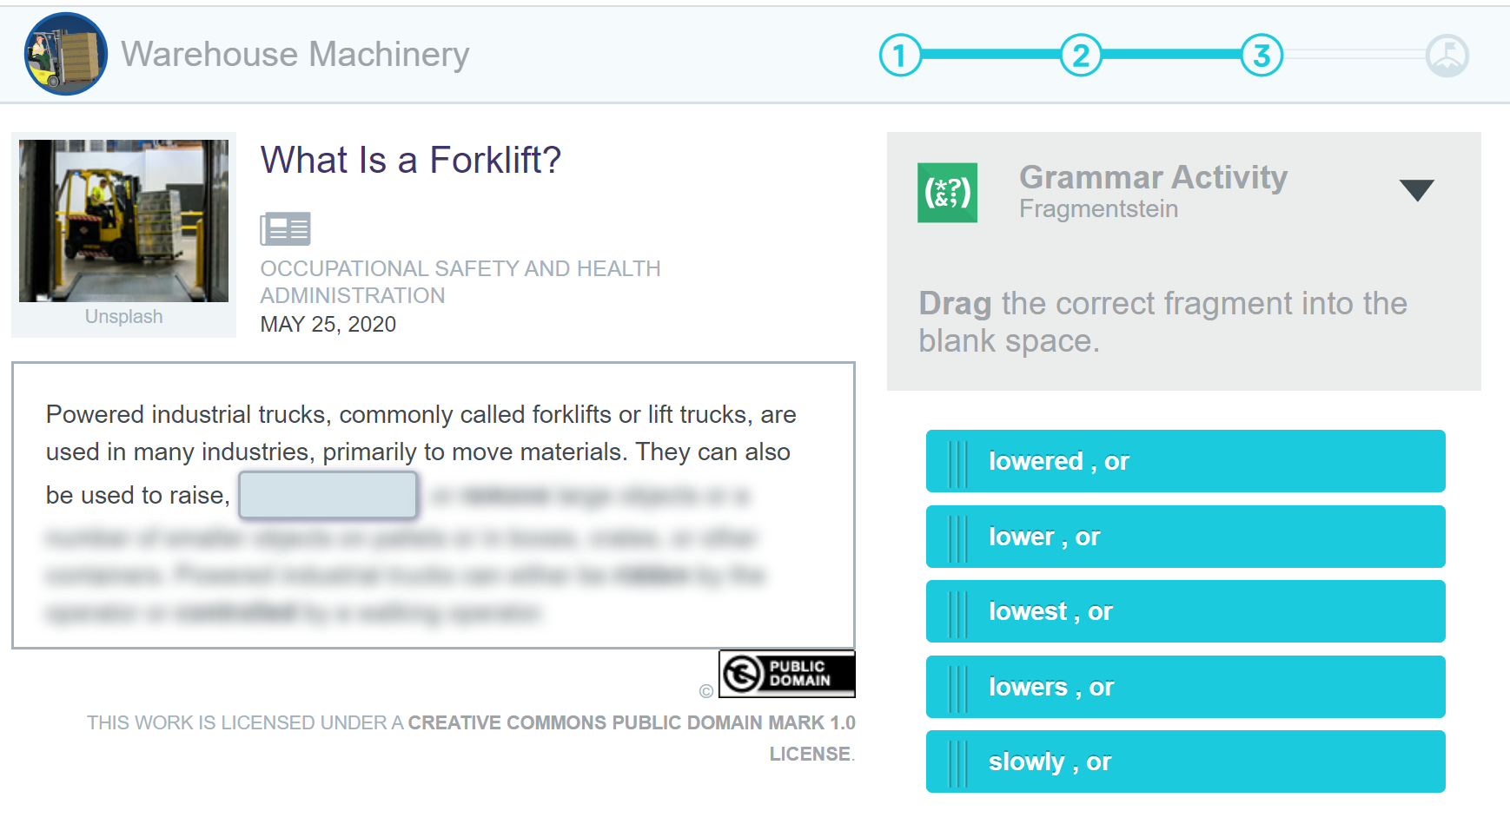
Grammar Exercises:
Verb tenses
Modal verbs
Prepositions
Conjunctions

Slide 37
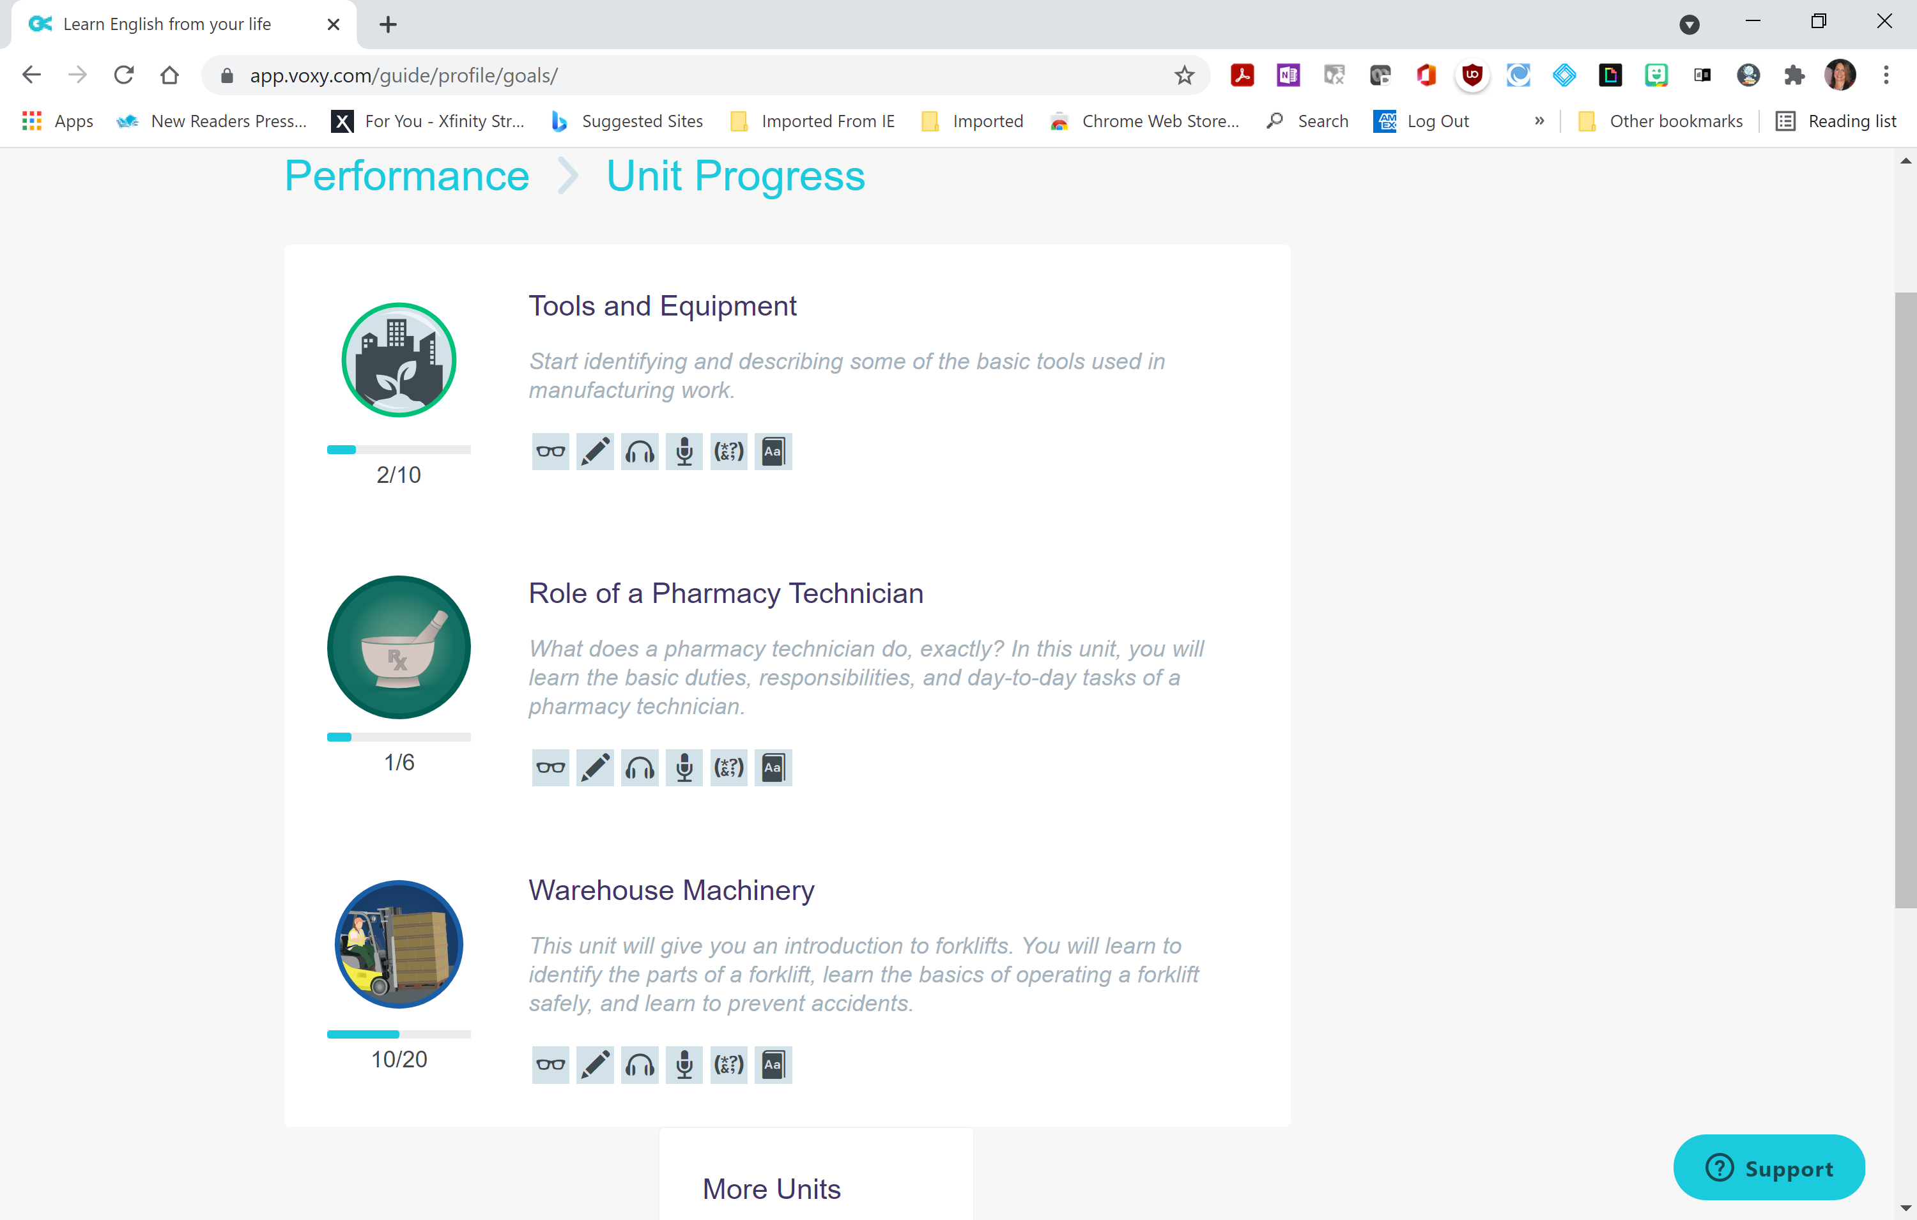
Unit Progress Details
Review progress by course
Notes:
Students can easily monitor their own progress and find the number of lessons remaining in a career pathway.

Slide 38
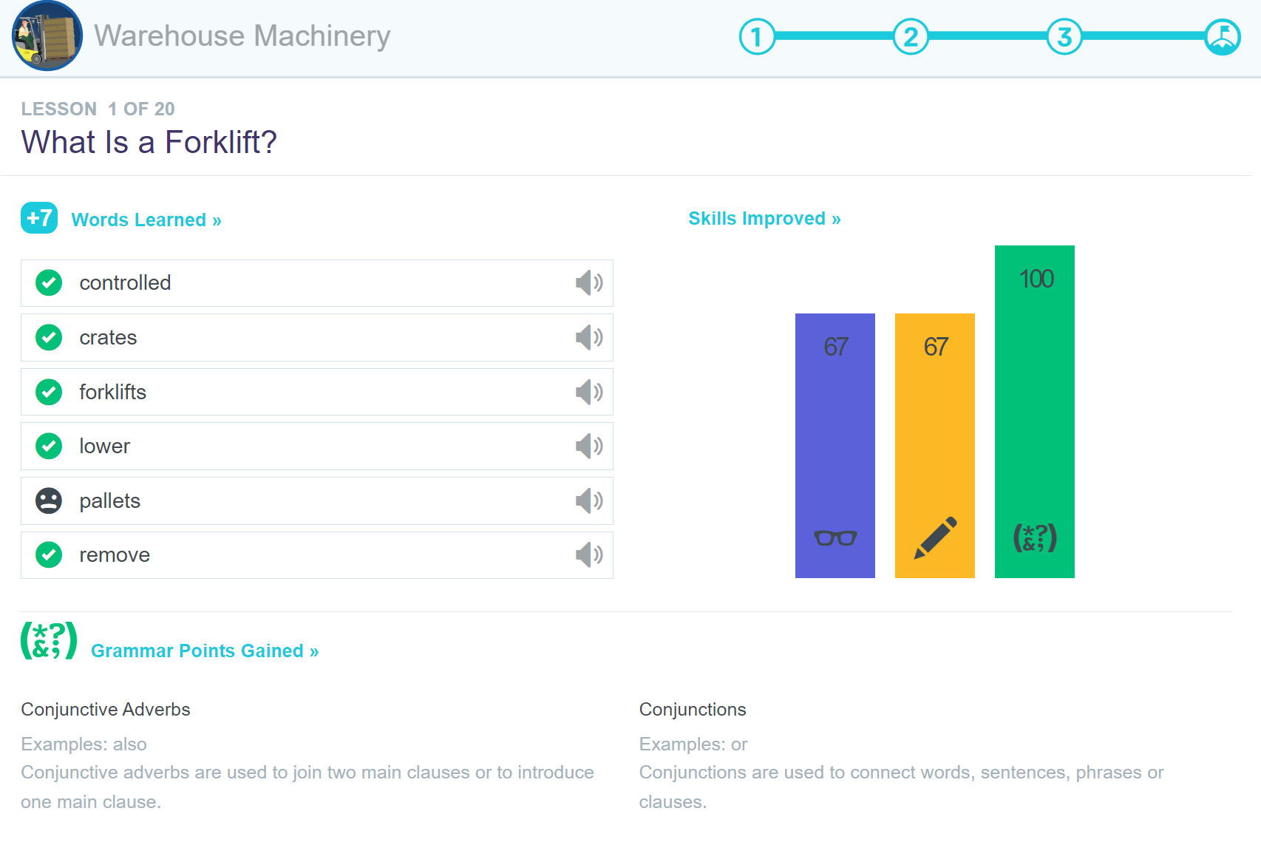
Immediate Feedback Provided to the Learner:
Listen to and practice saying vocabulary terms
Learn standard English conventions in practical terms
Visual representation of learned skills

Slide 39
Independent Review and Study:
Increase speaking, listening and pronunciation skills through more independent learning

Slide 40
Questions?
Ken Barr
ken@kbarr.com
602-617-7742
https://bit.ly/AEA-UT2021
Goodies!

